Slide 1
Advanced analytics to drive growth in B2B sales
Client context
Approach
Impact
Leading logistics player with over $15B in revenue
Flat revenue and margin growth in its largest business group
5 data scientists working for 2 years to develop complex churn and pricing models with limited sales uptake of tools and process
Rapid diagnostic of sales and pricing opportunities
Advanced analytics (e.g., machine learning, random forest) on lead generation, upsell, and pricing opportunities
McKinsey implementation to build capabilities and drive a pilot program
Digital McKinsey to build tableau and embed performance management in CRM
Multi-stage roll-out with a pilot proof point that rapidly scales
+4% p.a.
Revenue
+5% p.a.
Pricing
+44% p.a.
Profit
Q4 2017
Q4 2018
Rolled out nation wide with 400+ sales roles trained in <6 months
Client name: X
Team set-up: X
Fees Structure: X
What was unique: X
SOURCE: McKinsey Pricing Practice

Slide 2
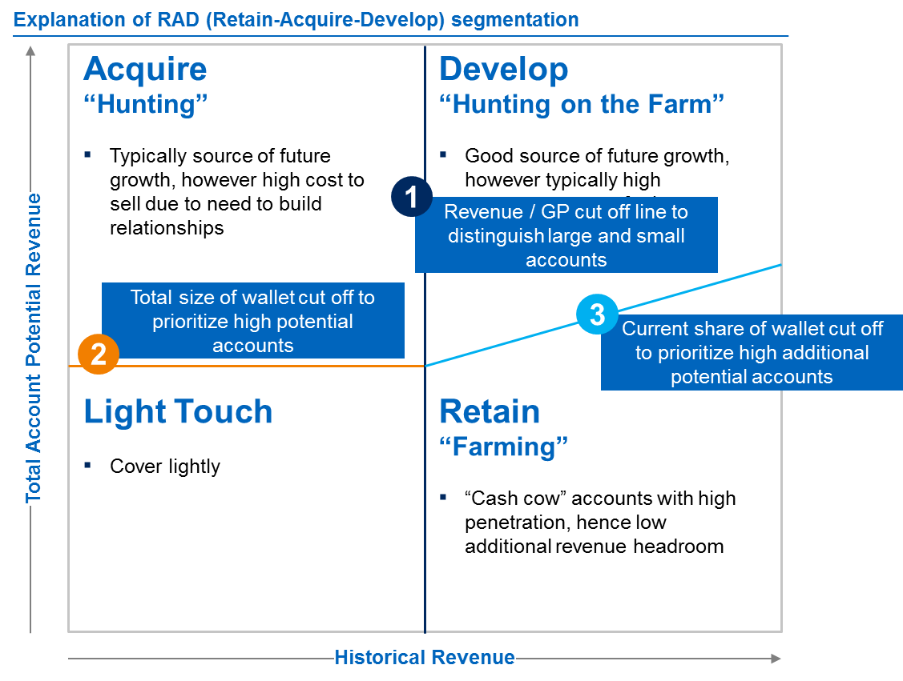
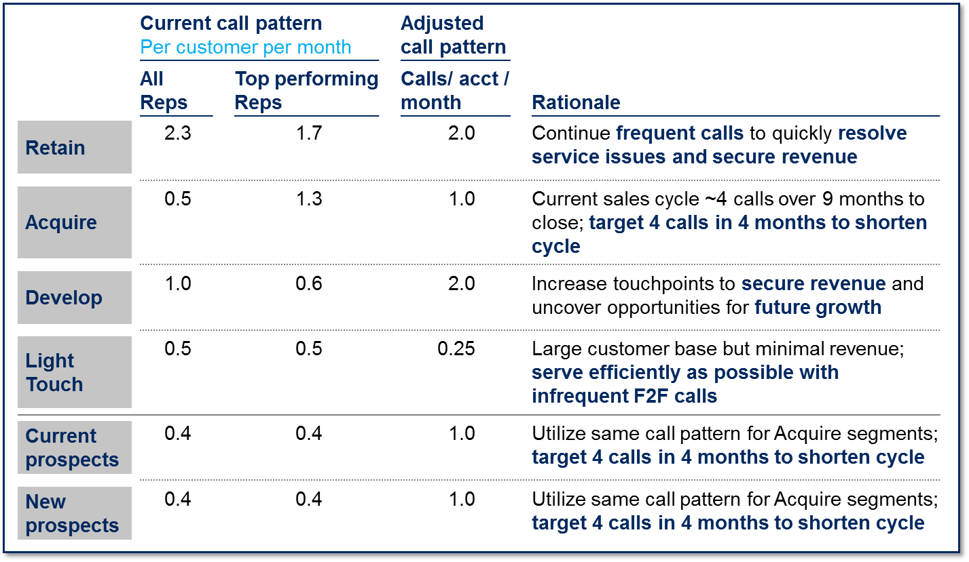
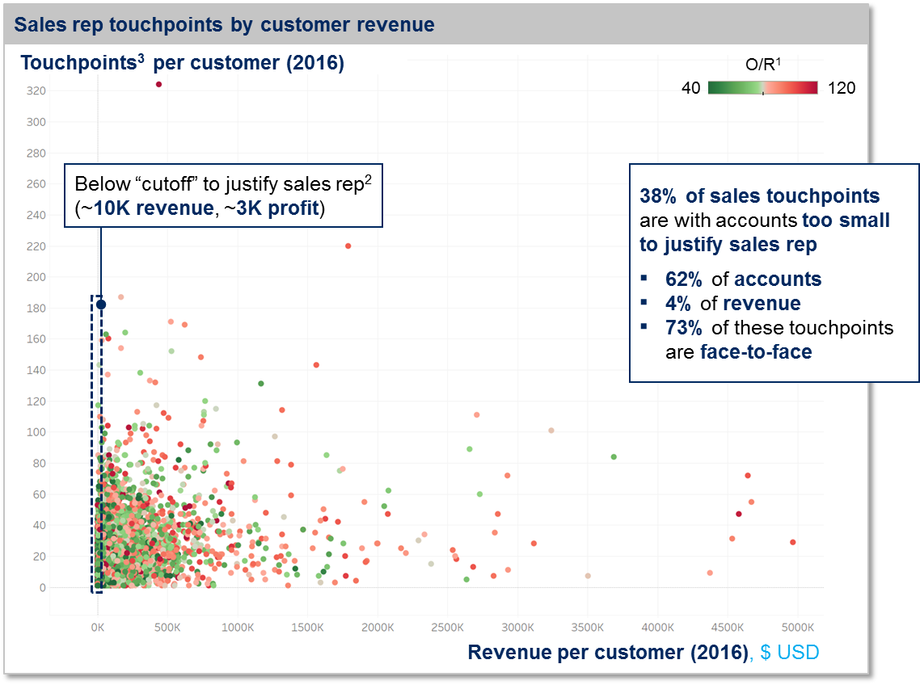
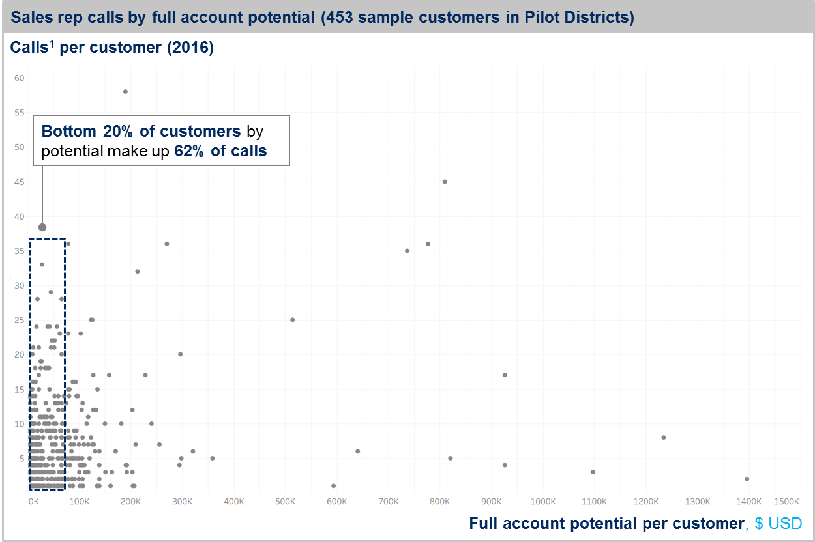
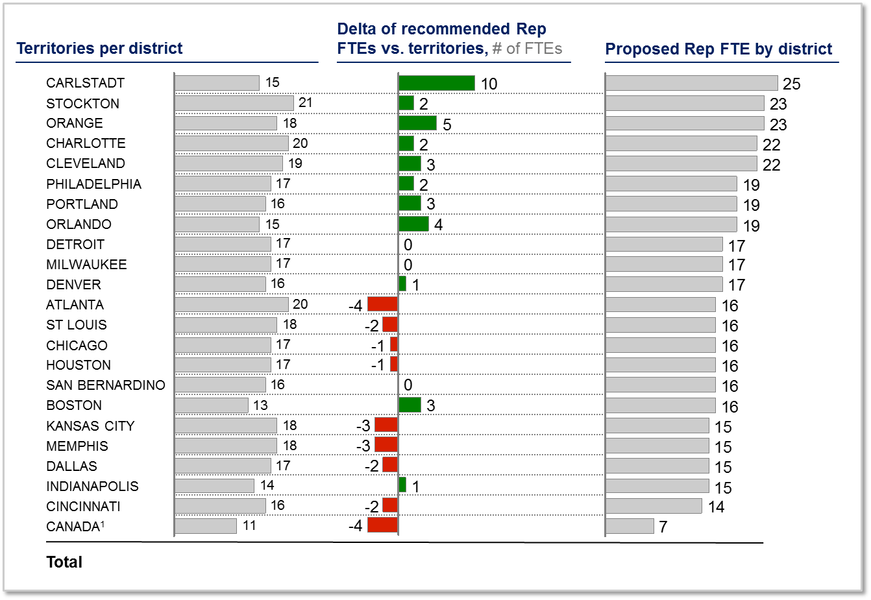
Used the analytics to identify better customer leads (and the customer’s revenue potential) and design sales routines and coverage model to increase focus on new business
COVERAGE MODEL
We used full potential analytics to develop segmentation based on current and future potential
… and identified the optimal customer call pattern to free Rep capacity for prospecting
We further identified rep call patterns against account performance …
… which helped reps visualize valuable return on invested time…
… and produced optimal coverage model when applied with analytics

Slide 3
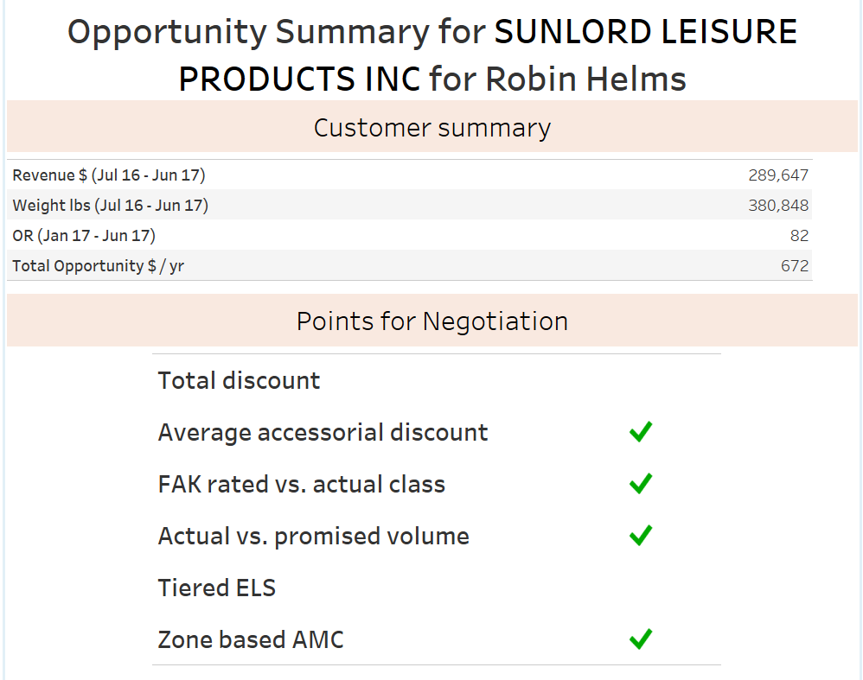
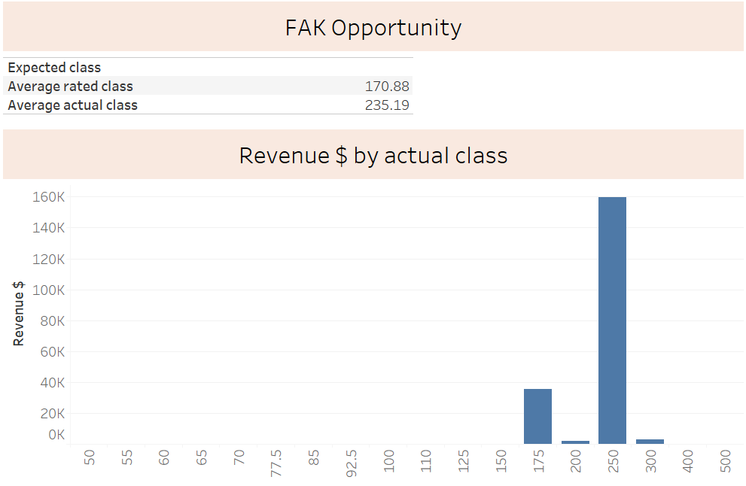
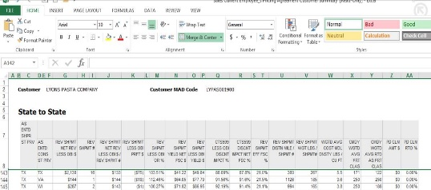
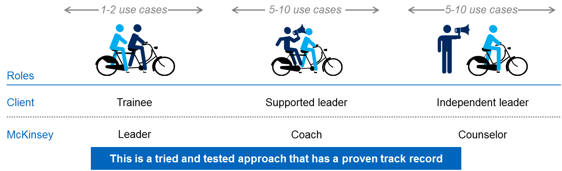
Pilot within 8 weeks with digital visualizations and McKinsey implementation support to prove analytics drive value – transitioned to client and scaled to 400+ sellers
Translated the analytics insights for the front line
Generated a set of actionable insights for each priority customer based on the analytics (e.g., specific price levers driving the opportunity, peer customers who also converted)
Worked with front line managers to ensure data-driven, action-orientated coaching would occur with every Rep
Built frontline sales capabilities using our Build, Operate, Transfer model
Build
Operate
Transfer
Led the design phase of the capability building modules and initial kick-off training
Conducted ongoing training with front line leaders observing and assisting
Transferred the coaching to the front line managers and provided support as needed
Roles
Client
Trainee
Supported leader
Independent leader
McKinsey
Leader
Coach
Client

